Slide 1
Section 7 Deep Learning in Watson Studio [Predictive Data Science]

Slide 2
Workshop Agenda – Section 7
Deep Learning with Watson Studio
A perspective on Deep Learning
Lab 7:

Slide 3

Deep Learning

Slide 4
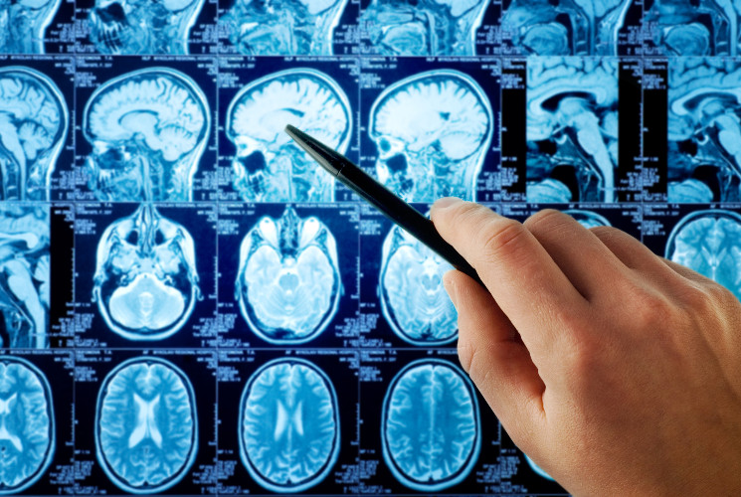
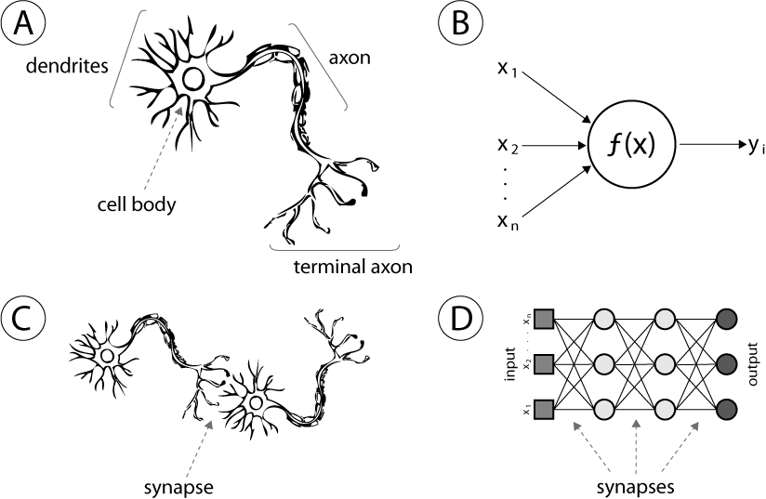
Neural Networks
(A) Human Neuron (B) Artificial Neuron
(C) Biological Synapse (D) Artificial Neural Network synapse
Notes:
(A) Human neuron; (B) artificial neuron or hidden unity; (C) biological synapse; (D) ANN synapses.

Slide 5
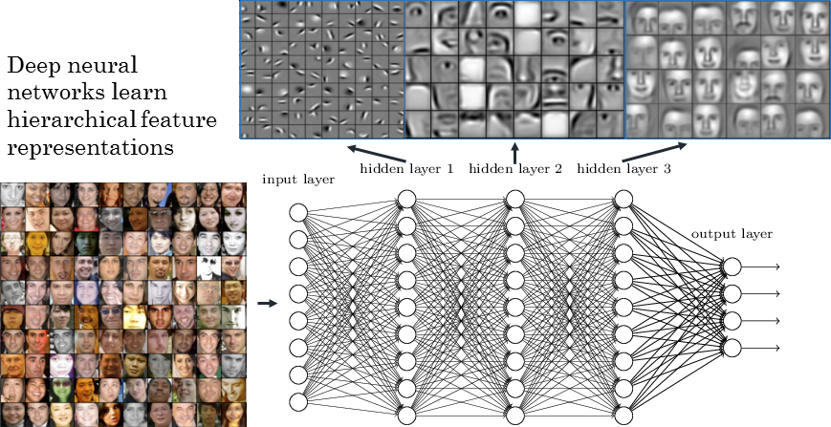
Deep Learning
Deep Learning algorithms learn “Feature Hierarchies” as they progresses through their hidden layers

Slide 6
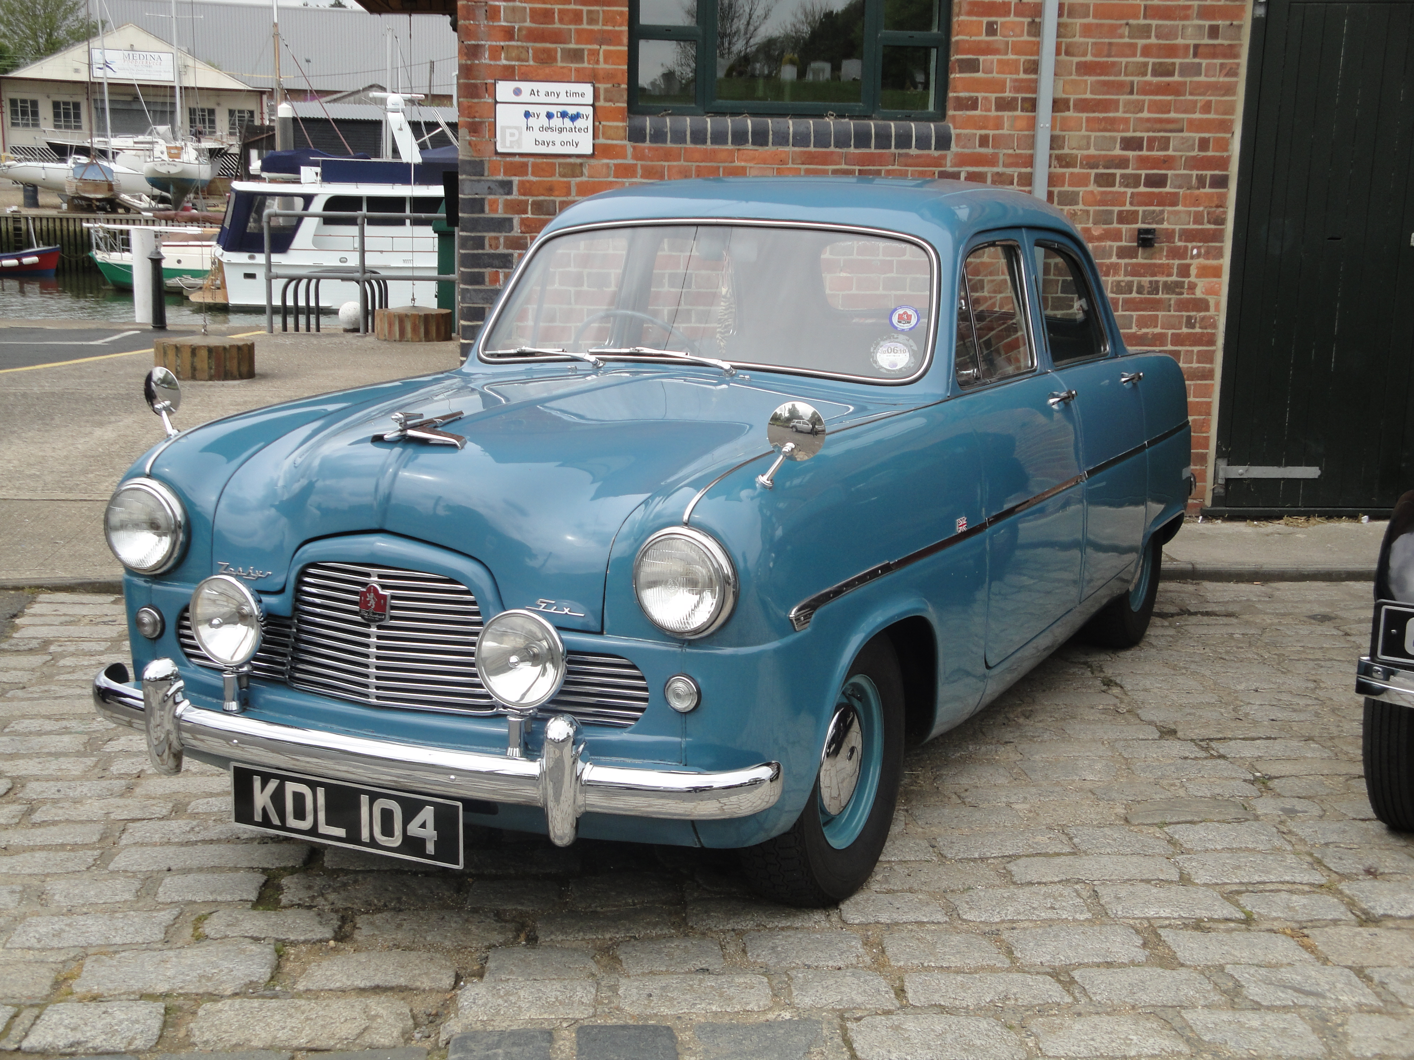

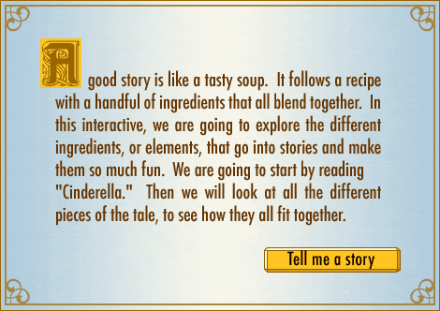
Deep Learning fields of application
Deep Learning is structured to be effective in
problem domains which have an inherently Hierarchical Composition
VISION
pixels -> edge -> texton -> motif -> part -> object
SPEECH
sample -> spectral band -> formant -> motif -> phone -> word
NATURAL LANGUAGE PROCESSING
character -> word -> clause -> sentence -> story

Slide 7
Deep Learning with Watson Studio
Enabled through Python Deep Learning libraries
Preinstalled for use in Watson Studio notebooks
TensorFlow
Theano
Keras
Lasagne
Model builder for Deep Learning
Provides a UI-driven Deep Learning model builder

Slide 8
Thank You philippe.gregoire@fr.ibm.com

Slide 9
Notices and Disclaimers
Copyright © 2016 by International Business Machines Corporation (IBM). No part of this document may be reproduced or transmitted in any form without written permission from IBM.
U.S. Government Users Restricted Rights - Use, duplication or disclosure restricted by GSA ADP Schedule Contract with IBM.
Information in these presentations (including information relating to products that have not yet been announced by IBM) has been reviewed for accuracy as of the date of initial publication and could include unintentional technical or typographical errors. IBM shall have no responsibility to update this information. THIS DOCUMENT IS DISTRIBUTED "AS IS" WITHOUT ANY WARRANTY, EITHER EXPRESS OR IMPLIED. IN NO EVENT SHALL IBM BE LIABLE FOR ANY DAMAGE ARISING FROM THE USE OF THIS INFORMATION, INCLUDING BUT NOT LIMITED TO, LOSS OF DATA, BUSINESS INTERRUPTION, LOSS OF PROFIT OR LOSS OF OPPORTUNITY. IBM products and services are warranted according to the terms and conditions of the agreements under which they are provided.
IBM products are manufactured from new parts or new and used parts. In some cases, a product may not be new and may have been previously installed. Regardless, our warranty terms apply.”
Any statements regarding IBM's future direction, intent or product plans are subject to change or withdrawal without notice.
Performance data contained herein was generally obtained in a controlled, isolated environments. Customer examples are presented as illustrations of how those customers have used IBM products and the results they may have achieved. Actual performance, cost, savings or other results in other operating environments may vary.
References in this document to IBM products, programs, or services does not imply that IBM intends to make such products, programs or services available in all countries in which IBM operates or does business.
Workshops, sessions and associated materials may have been prepared by independent session speakers, and do not necessarily reflect the views of IBM. All materials and discussions are provided for informational purposes only, and are neither intended to, nor shall constitute legal or other guidance or advice to any individual participant or their specific situation.
It is the customer’s responsibility to insure its own compliance with legal requirements and to obtain advice of competent legal counsel as to the identification and interpretation of any relevant laws and regulatory requirements that may affect the customer’s business and any actions the customer may need to take to comply with such laws. IBM does not provide legal advice or represent or warrant that its services or products will ensure that the customer is in compliance with any law

Slide 10
Notices and Disclaimers Con’t.
Information concerning non-IBM products was obtained from the suppliers of those products, their published announcements or other publicly available sources. IBM has not tested those products in connection with this publication and cannot confirm the accuracy of performance, compatibility or any other claims related to non-IBM products. Questions on the capabilities of non-IBM products should be addressed to the suppliers of those products. IBM does not warrant the quality of any third-party products, or the ability of any such third-party products to interoperate with IBM’s products. IBM EXPRESSLY DISCLAIMS ALL WARRANTIES, EXPRESSED OR IMPLIED, INCLUDING BUT NOT LIMITED TO, THE IMPLIED WARRANTIES OF MERCHANTABILITY AND FITNESS FOR A PARTICULAR PURPOSE.
The provision of the information contained h erein is not intended to, and does not, grant any right or license under any IBM patents, copyrights, trademarks or other intellectual property right.
IBM, the IBM logo, ibm.com, Aspera®, Bluemix, Blueworks Live, CICS, Clearcase, Cognos®, DOORS®, Emptoris®, Enterprise Document Management System™, FASP®, FileNet®, Global Business Services ®, Global Technology Services ®, IBM ExperienceOne™, IBM SmartCloud®, IBM Social Business®, Information on Demand, ILOG, Maximo®, MQIntegrator®, MQSeries®, Netcool®, OMEGAMON, OpenPower, PureAnalytics™, PureApplication®, pureCluster™, PureCoverage®, PureData®, PureExperience®, PureFlex®, pureQuery®, pureScale®, PureSystems®, QRadar®, Rational®, Rhapsody®, Smarter Commerce®, SoDA, SPSS, Sterling Commerce®, StoredIQ, Tealeaf®, Tivoli®, Trusteer®, Unica®, urban{code}®, Watson, WebSphere®, Worklight®, X-Force® and System z® Z/OS, are trademarks of International Business Machines Corporation, registered in many jurisdictions worldwide. Other product and service names might be trademarks of IBM or other companies. A current list of IBM trademarks is available on the Web at "Copyright and trademark information" at: www.ibm.com/legal/copytrade.shtml.

